Slide 1
Intelligent Territory Alignment
Praven Kumar
June 2025

Slide 2
Intelligent Territory Alignment
Objective:
Currently, the finance team manually assigns sales representatives to customer locations (Ship-To). Our goal is to automate and optimize this process using advanced algorithms. By leveraging genetic algorithms, we aim to:
Minimize travel distance between sales reps and customers for better efficiency.
Balance revenue distribution across all sales reps to ensure fair workload and performance consistency.
This approach helps create an optimized alignment that improves productivity, reduces travel costs, and supports equitable revenue opportunities for the entire sales team.
Data summary:
Ship To level data -
Demographics of customer – Geo location, Name.
Financial Info - Revenue/Sales (For 1 year) by Ship To’s.
Hierarchy Info - Lvl3, Lvl4, Lvl5 associated with Ship To’s.
Total Rows (SIG – SCSE(Distributor SIG), ANCR, ORSP & SPEC (Product SIG’s)) – 46K (Each row is Ship To level data).
Sales rep information –
Demographics of sales rep - Geo location, Name, ID.
Hierarchy Info - Lvl3 & Lvl4 associated with sales rep (Lvl5).
Total Rows (SIG – SCSE(Distributor SIG), ANCR, ORSP & SPEC (Product SIG’s)) – 350 (Each row is sales rep data).

Slide 3
Intelligent Territory Alignment
Genetic algorithm – an overview:
Gene List - Before generating a gene list, first we assign a unique identity number for each sales rep and thus for all 61, ranging from 0-60.
In total we have 10K Ship To level data and for each Ship To (customer) a sales rep is assigned by the finance team and for this sales rep the respective unique identity is used. Now for 10K Ship To’s we have an initial array of sales rep allocation of length 10K which is our gene list.
We optimize/reshuffle this manual alignment of sales reps (gene list) across all Ship To’s in iterations so that we can reduce the distance of travel and try to achieve balanced revenue share by reducing the St. Deviation of revenue across sales reps.
Genetic algorithm simulate the process of natural selection. Which means those genes that can adapt to changes in their environment can survive and reproduce and go to the next generation.
Each generation consists of a population of individuals/genes and every individual represents a point in search space and possible solution.

Slide 4
Intelligent Territory Alignment
Components of genetic algorithm:
Fitness score
Selection
Crossover
Mutation
Fitness score:
Fitness score is given to each gene list based on distance of travel and St. Deviation of revenue across sales reps.
Formula used:
Revenue St. Deviation = - (St. Deviation(Revenue distribution across sales reps)/1000)
Average distance = - (Average(Total distance traveled (rep to customer) across sales reps))*1000
Total error = - Revenue St. Deviation - Average distance - VP error

Slide 5
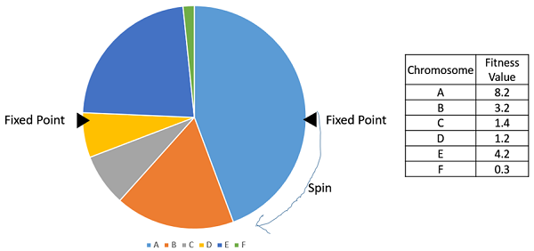
Intelligent Territory Alignment
Selection operator:
To give preference to the individuals with good fitness scores and allow them to pass their genes to successive generations.
Stochastic universal sampling (SUS):
There are two fixed points.
All the individuals/parents are chosen in just one spin of the wheel; this setup encourages the highly fit individuals to be chosen at least once.

Slide 6

Intelligent Territory Alignment
Crossover operator:
Represents mating between individuals. Two individuals are selected using selection operator and crossover sites are chosen randomly. Then the genes at these crossover sites are exchanged thus creating a completely new individual (offspring).
Mutation:
Mutation may be defined as a small random tweak in the gene list, to get a new solution. It is used to maintain and introduce diversity in the genetic population.
Algorithm run time:
The average time taken to produce best optimized distributor rep (Level 5) allocation for 10K Ship To level data is 4 business days.

Slide 7
Model findings – June 2025 –
(Both distributor and product SIG)
At the VP level, the count of customers and revenue distribution did not change, but did on the Sales Rep level
SCSE
ANCR
ORSP
SPEC
328 customers realigned
40.01k miles reduced
Avg 21% Revenue Std. Deviation % Difference across all VPs.
394 customers realigned
258.63k miles reduced
Avg 0.48% Revenue Std. Deviation % Difference across all VPs.
344 customers realigned
20.k miles reduced
Avg 5.15% Revenue Std. Deviation % Difference across all VPs.
372 customers realigned
30.20k miles reduced
Avg 31.23% Revenue Std. Deviation % Difference across all VPs.

Slide 8
Intelligent Territory Alignment
Optimizing product rep alignments:
Once we achieve defined territories/clusters for each distributor rep, we performed similar optimization of product rep alignments for SIG’s – ANCR, ORSP & SPEC.
In total we had 46K Ship To level data and 151 unique product reps associated to the Ship To’s.
Using genetic algorithm, we were able to achieve optimized product rep clusters with reduced no. of outliers.
In this iteration, we used distance of travel by a product rep as only key feature for optimization.
Algorithm run time:
Since we have 46K Ship To level data for product SIG’s, which is 5X than that of distributor SIGs. The average time taken to produce best optimized product rep (Level 5) allocation for 46K Ship To level data is 10 business days.

Slide 9
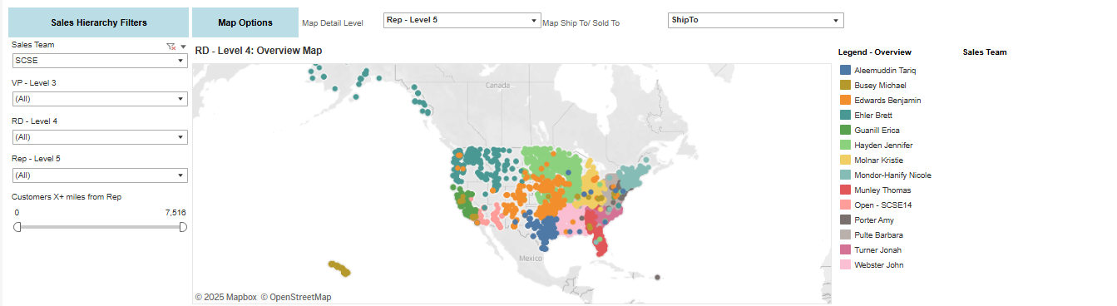
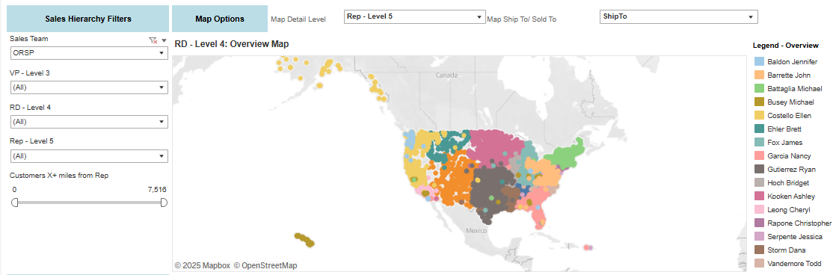
Intelligent Territory Alignment
14 reps
Somewhat grouped Territories
Territory outliers that would increase drive distance
Distributor rep clusters - current
16 reps
Somewhat grouped Territories
Territory outliers that would increase drive distance
Not aligned to the same SCSE territories, which increases coordination needed across reps
Product rep clusters - current

Slide 10
Intelligent Territory Alignment
14 reps
Clearly identified territories
Distributor rep clusters - expected
16 reps
Clearly identified territories
Mapped to align to the SCSE territories, with allotment for difference in rep numbers
Product rep clusters - expected

Slide 11
Intelligent Territory Alignment
Appendix

Slide 12
Intelligent Territory Alignment
Data Flow
Monthly Sales
INTEGRATED_SALES_SIG_MONTHLY_ATLAS_SNAPSHOT
D2 EDDIE Model
Territory Explorer
New D2 Input Table
New Output Table
Sales Rep File
TBD
INTELLIGENT_TERRITORY_ALIGNMENT
Provided by *Kate Shrager
Build
EDnA
A new input D2 is needed to bring in the Sales Rep location data for the model
EDDIE
Tableau

